Slide 1

Automated Visual Inspection using CNN
Git hub : https://github.com/Aryaremani/Automated-Visual-Inspection-using-CNN
Streamlit: https://automated-visual-inspection-using-cnn.streamlit.app/
Team Members:
Abhi P Vijay
Anamika A
Arya R

Slide 2
Problem Statement
Manual inspection of bottles in manufacturing is time-consuming, inconsistent, and prone to human error, making it inefficient for high-speed production lines. Therefore, an automated system using Convolutional Neural Networks (CNN) is needed to accurately and consistently detect defects in bottles in real time.

Slide 3
DATASET OVERVIEW
MVTec Anomaly Detection — Bottle Dataset
Purpose: Industrial anomaly detection benchmark for bottle defects (e.g., cracks, contamination, scratches).
Dataset Size: Part of MVTec AD (5,354 images across 15 categories).
Training Data: Defect-free bottle images for unsupervised learning.
Test Data: Mix of normal + anomalous bottles with pixel-level annotations.

Slide 4
METHODOLOGY - DATA SCIENCE LIFE CYCLE
Model Building & Training
Model Evaluation & Comparison
Model Interpretation & Explainability
Deployment (Streamlit)
Documentation (README, PPT, GitHub)
Problem Definition & Literature Review
Data Collection & Understanding
Data Preprocessing & Cleaning
Exploratory Data Analysis (EDA)
Feature Engineering & Selection

Slide 5
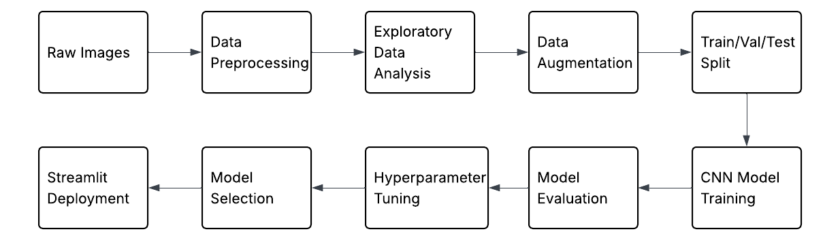
PIPELINE

Slide 6
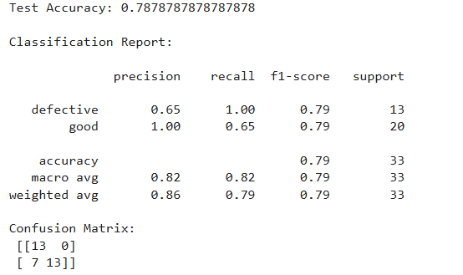
Results
The model achieved a test accuracy of approximately 79%. The confusion matrix shows that all defective samples were correctly identified, resulting in a recall of 1.00 for the defective class. This indicates that the model is highly effective in detecting defects.

Slide 7

DEPLOYED APPLICATION

Slide 8
Limitations
Bias towards defect detection due to class imbalance
Limited dataset size reduces generalization capability
Model may not handle complex or unseen defect types effectively

Slide 9
FUTURE WORKS
Increase dataset size and include more diverse samples
Implement real-time defect detection in production systems
Extend to multi-class defect classification

Slide 10
CONCLUSIONS
The model achieved an accuracy of approximately 79%
Some normal images were misclassified as defective due to bias towards defect detection
Overall, the system demonstrates the effectiveness of CNN-based automated visual inspection

Slide 11

GITHUB INSIGHTS

